Slide 1
Parent Information
www.loughriesips.com
Always check the website regularly for information.
Download the School App to help keep you up to date with all information added to the website.
Please ensure your contact details are up to date.

Slide 2
The New School Day
For health and safety we will be operating a staggered drop off/pick up routine. The
Visual drop off/pick up plan is available on the school website.
Our current plan is to phase the children back into school. Phase 1 will involve P5/6 coming back to school on Wednesday 26th August from 8:30am – 12 noon. Phase 2 from the week beginning Monday 31st August, P5/6 will start school at 8:30 am and finish at 2:05pm.
Please remember to park appropriately outside school leaving the entrance gate clear.
Children will be dismissed from the front door following the Visual drop off/pick up plan. An adult must follow the plan and wait beside a painted stone. The class teacher will send out your child from the front door when you are in the waiting zone. If you have arranged for another parent or adult to collect your child then please let me know.

Slide 3
School Uniform
Girls
Grey skirt
White polo shirt with school logo
Red sweatshirt with school logo
Red/white check dress (summer)
Black shoes
Boys
Grey trousers
White polo shirt with school logo
Red sweatshirt with school logo
Grey shorts (summer)
Black shoes

Slide 4
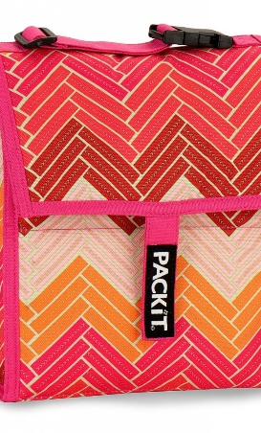
Break and Lunch
Break Time
Children are encouraged to eat a healthy break in class, Monday to Thursday. Friday is the one day in the week where they can enjoy a small treat.
Lunch Time
At present the children will only be able to eat their packed lunch in their class bubble within their classroom. School Dinners will be providing a sandwich, piece of fruit and a drink from Tuesday 1st September and this can be ordered through the School Money set up. All orders for the week ahead are to be completed on the Friday before the next week through School Money. Information regarding the School Money set up will be communicated to you in August.
12:35 – 1:00pm Eat in the classroom & toilet break
1:00pm – 1:30pm Outside Play.
We are a nut free school and have children in the class with severe nut allergies. Please check all food items before sending them into school. Thank you.

Slide 5
Money
This year we intend to collect all money through the School Money App.
School Fund
School Meals
If you are new to the school, Mrs Emery will set you up on the system as soon as possible.

Slide 6
Pastoral Care/Communication
If you have a worry or concern about your child or wish to communicate with the class teacher, then please phone the school office between 9:30 and 9.45am and Mrs Emery will pass the information on to the class teacher. The class teacher will then return a call when they have finished teaching.
Miss Miller is Designated Child Protection Teacher and Mr Stewart is the Deputy Designated Child Protection Teacher.

Slide 7
Absence from school
If your child is ill they should remain at home. If they are well enough to attend school, but need to take medicine please fill in an ‘Administration of Medicine’ form and hand the medicine to the Staff member at the front door in a named plastic bag.
Please note medicines cannot be administered without this consent.
We are asking all Parents/Carers to communicate a child’s absence by email to: info@loughriesips.newtownards.ni.sch.uk before 9:30am on the first day of sickness.
If anyone in your family is showing symptoms of Coronavirus then do not send your child to school. Follow the current advice on the Public Health Agency website: www.publichealth.hscni.net

Slide 8
Topics
The Human Body
Ancient Egyptians
Reduce, Reuse, Recycle
Natural Disasters

Slide 9
Literacy
Talking and Listening
Reading
Writing

Slide 10
Linguistic Phonics
Monday
A target sound is introduced and a text is read to the children, Every-time they hear a word which contains the target sound they record this on a whiteboard.
Tuesday
Word Sort the children sort the words into the categories.
Wednesday
The children highlight the target sound in a piece of text.
Thursday
See it right. Words are displayed and the children choose the correct spelling.
Friday
Friday Focus. This will be sent home so please do check this.

Slide 11
Reading
The children will take part in reciprocal reading or small group reading or individual reading in school.
We are currently looking at online websites for access to more reading material as we can not have books being sent home and returned each day due to health and safety.
It is recommended that they read for at least 15mins each day. A child should never be without a book.
Reading with your child at home is critical in supporting their progress. Children should be reading aloud to an adult every night – I cannot stress this enough.
The following websites have books available online:
www.librariesni.org.uk and www.oxfordowl.co.uk

Slide 12
Numeracy
Mental Maths
Processes in Mathematics, Number, Measures, Shape and Space and Handling Data.
Numeracy Games
Word Problems
Problem Solving
P5/6 is an important time for learning times tables and division facts. Children should be working on these at home every day.

Slide 13
Useful Websites
www.IXL.com
www.topmarks.co.uk
www.corbettmathsprimary.com
www.crickweb.co.uk
www.sumdog.com
www.oxfordowl.co.uk
www.bbc.co.uk/bitesize
www.librariesni.org.uk

Slide 14
P5/6 PE
We will endeavour to offer our children P.E. on a Monday and Thursday at school.
This Photo by Unknown Author is licensed under CC BY-SA

Slide 15
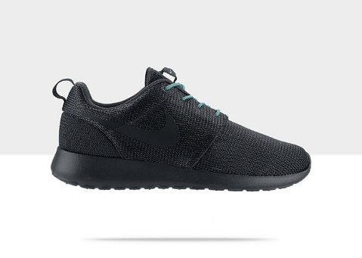
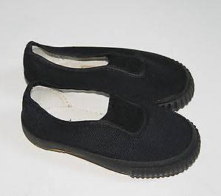
PE Uniform
Red Jumper with School Logo
White polo shirt
Black jogging bottoms
Black or white trainers
Children should come to school wearing their P.E. Kit on the P.E. day which is Monday and Thursday.
There will be no PE on Thursday 27th August.

Slide 16
AQE/PPTC
Dates and information about AQE and PPTC transfer tests for 2021 have not yet been issued.
More information will be provided about the tests later in the year as well as an expression of interest form for parents of P6 children who are interested in sitting the tests.

Slide 17
Reporting to Parents
There will be two Parent/Teacher meetings and one written report in June.
The first parent teacher meeting will be held in October. (TBC)
A second meeting will be held in February.
An information meeting about Transfer Tests for P6 children will be held in January (TBC).

Slide 18
Digital Assessments
A Progress Test in Maths and a Progress Test in English will be taken during April/May.
Encourage your child to participate with Sumdog as these skills gained will be very helpful for your child when completing the PTM.

Slide 19
Homework
The children will be asked to complete the following activities:
Learn Spellings
Learn Tables
Learn Numeracy Facts
Learn Literacy Facts
Reading
Written work
Topic work
The work will be given to the children on the Monday and I would ask that it is only returned in the plastic wallet on the Thursday.
Please encourage your child to have a snack and drink before they begin homework. They should have a quiet place to complete homework with limited distractions. Parents are expected to look at their child’s work and raise any concerns with learning with the class teacher.
There will be no written homework for the first couple of weeks to ease children back to school after a long break.
The Homework Policy is available on the school website.

Slide 20
PTFA
The PTFA is made up of Parents and Mrs Bowers is the Teacher Representative. They organise different events throughout the year to help support our children. If you are interested in joining the PTFA then send me an email and I will pass your contact details on to them: gstewart525@c2kni.net

Slide 21
Stay in touch
I hope that your children had a good rest over the break. It has been a very disruptive time for everyone and I’m sure that while many children will be excited to get back to school, some will also feel anxious.
The school day will be different but I will do everything that I can to help make the restart as easy as possible for your child.
If you have any concerns or anything you would like to raise, please feel free to get in touch.
Thank you for taking the time to go through this presentation.

